Slide 1

ELECTRONIC VOTING SYSTEM
TEAM ID :NM2023TMID11693
By:
Dharshini N (731620104012)
Divya R (731620104013)
Krishani M (731620104030)
Thilothama D (731620104055)

Slide 2
Abstract:
Increasingly digital technology in the present helped many people lives. Unlike the electoral system, there are many conventional uses of paper in its implementation. The aspect of security and transparency is a threat from still widespread election with the conventional system (offline). General elections still use a centralized system, there is one organization that manages it. Some of the problems that can occur in traditional electoral systems is with an organization that has full control over the database and system, it is possible to tamper with the database of considerable opportunities. Blockchain technology is one of solutions, because it embraces a decentralized system and the entire database are owned by many users. Blockchain itself has been used in the Bitcoin system known as the decentralized Bank system. By adopting blockchain in the distribution of databases on e-voting systems can reduce one of the cheating sources of database manipulation.

Slide 3
Problem Statement:
Blockchain is a technology which enables elections to be done transparently. We can avoid rigging or any corrupt activities using the technology and should be able to make sure that the votes are also accounted for on a real-time basis . Design an electronic voting system, using the ethereum blockchain (smart contracts) and more precisely the RPC test which enables account generation with a private and public key. Blockchain electronic voting system using smart contracts.

Slide 4
Our Solution:
To design an electronic voting system leveraging the Ethereum blockchain and RPC test for secure account generation can revolutionize the electoral process. Utilizing smart contracts, we can develop a Voter Registry to authenticate eligible voters, an Election Manager to oversee the voting lifecycle, and a Candidate Registry to manage candidate information. Voters can securely cast their votes via a user-friendly web interface, which interacts with the Voting System smart contract, ensuring transparency and preventing double voting. Real-time updates on votes can be accessed through blockchain explorers or web3.js, guaranteeing transparency and accountability. Secure storage practices and encryption protocols must be implemented to protect sensitive data. Additionally, the system should comply with legal regulations, educate voters on its usage, and prioritize accessibility for all eligible participants, thereby ensuring a transparent, secure, and inclusive electoral process.

Slide 5
Scope of the Project:
Blockchain
Blockchain is a distributed and decentralized digital ledger technology that records a chronological and immutable chain of transactions across a network of computers. Each set of transactions, known as a "block," is linked to the previous one, forming a chain.
The scope of the electronic voting system using blockchain project encompasses the design and development of a secure, transparent, and tamper-proof voting platform. This system will leverage blockchain technology, implementing smart contracts for voter registration and vote counting, with user authentication through cryptographic keys.

Slide 6
Steps taken to complete the project:
Step 1:
Open the Zip file and download the zip file. Extract all zip files
Step 2 :
1.Open vs code in the left top select open folder. Select extracted file and open .
2. Select the projectname.sol file and copy the code.
3. Open the remix ide platform and create a new file by giving the name of projectname.sol and paste the code which you copied from vs code.
4. Click on solidity compiler and click compile the projectname.sol
5. Deploy the smart contract by clicking on the deploy and run transaction.
6. select injected provider - MetaMask. In environment
7. Click on deploy. Automatically MetaMask will open and give confirmation. You will get a pop up click on ok.
8. In the Deployed contract you can see one address copy the address.
9. Open vs code and search for the connector.js. In contract.js you can paste the address at the bottom of the code. In export const address.
10. Save the code.

Slide 7
Step 3:
open file explorer
1. Open the extracted file and click on the folder.
2. Open src, and search for utiles.
3. You can see the frontend files. Select all the things at the top in the search bar by clicking alt+ A. Search for cmd
4. Open cmd enter commands npm install npm bootstrap npm start
5. It will install all the packages and after completing it will open {LOCALHOST IP ADDRESS} copy the address and open it to chrome so you can see the frontend of your project.

Slide 8
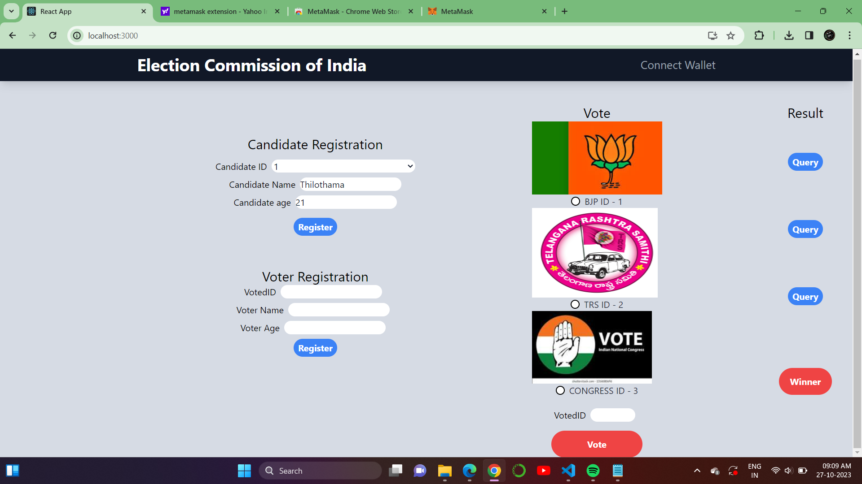
Output:

Slide 9
Conclusion:
In conclusion, the electronic voting system using blockchain technology offers a promising path towards revolutionizing the electoral landscape by addressing long-standing issues of trust, security, and transparency. By leveraging blockchain technology, e-voting systems can provide a faster and safer voting process, increase voter turnout, and improve trust in the election system. The implementation of smart contracts in blockchain can ensure the accuracy and privacy of the voting process. As the world continues to embrace digital transformation, the adoption of blockchain-based electronic voting systems has the potential to redefine the way societies conduct elections, fostering a more inclusive and trustworthy democratic landscape for the benefit of all.However, it is crucial to acknowledge that the adoption of such systems should be done with careful consideration of legal and practical challenges, ensuring that the benefits of blockchain technology are harnessed while mitigating potential risks and limitations.

Slide 10
THANK YOU

